Slide 1
What is the weather like today?

Slide 2
Good afternoon,
boys
girls

Slide 3
Today we’ll speak about …
weather

Slide 4
Let’s play a game “Hangman”
. . . . . .
п
о
г
о
д
а

Slide 5
Let’s play the game “Who is the winner?”
Кто больше
назовет слов
по теме
«Погода»

Slide 6
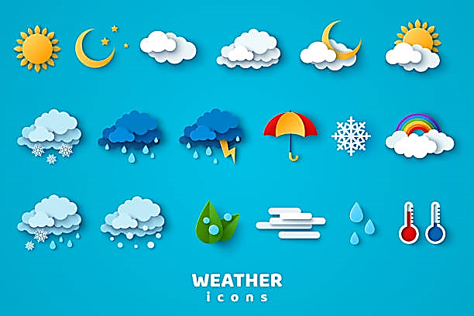
What is the weather like?

Slide 7
Sunny

Slide 8
Snowy

Slide 9
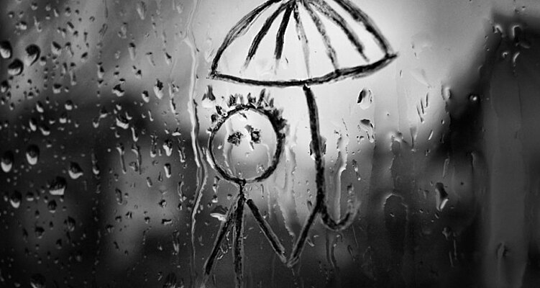
Rainy

Slide 10
Cloudy

Slide 11
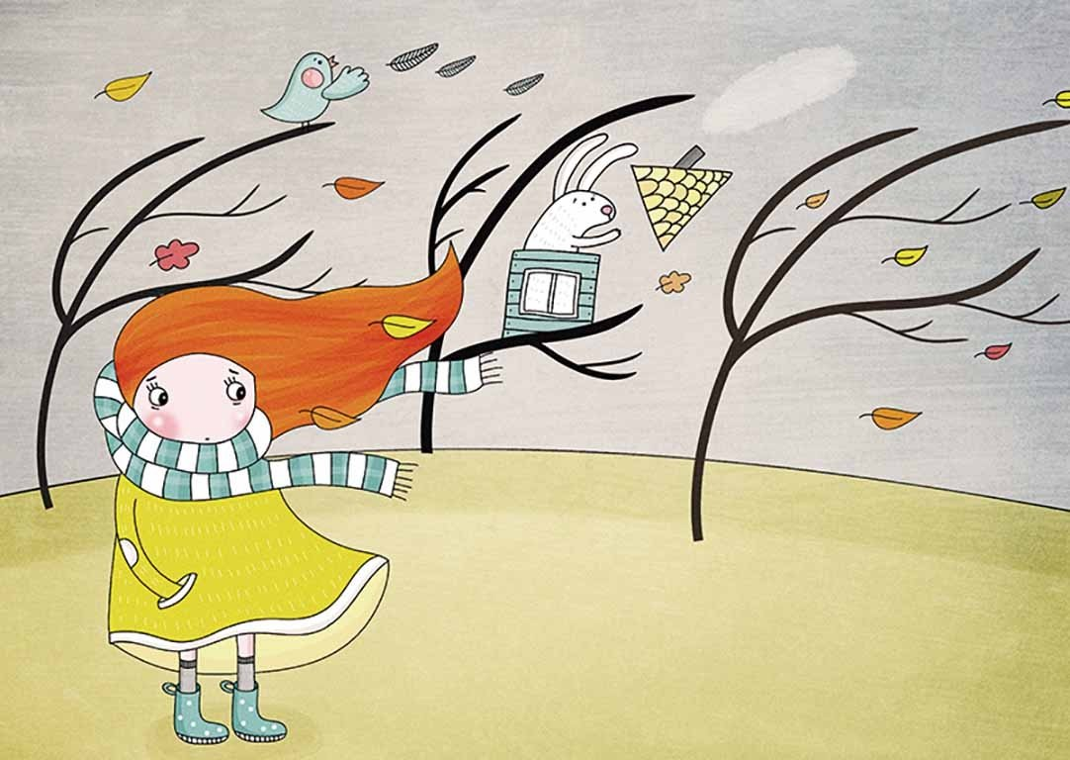
Windy

Slide 12
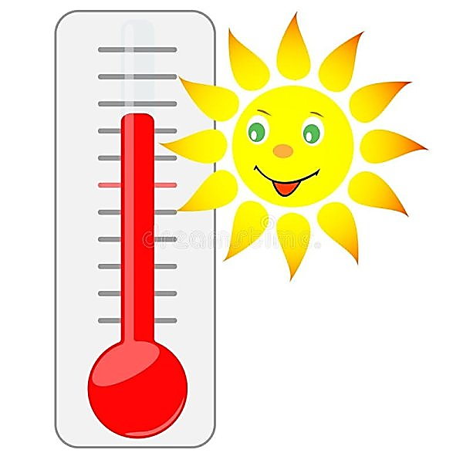
Warm

Slide 13
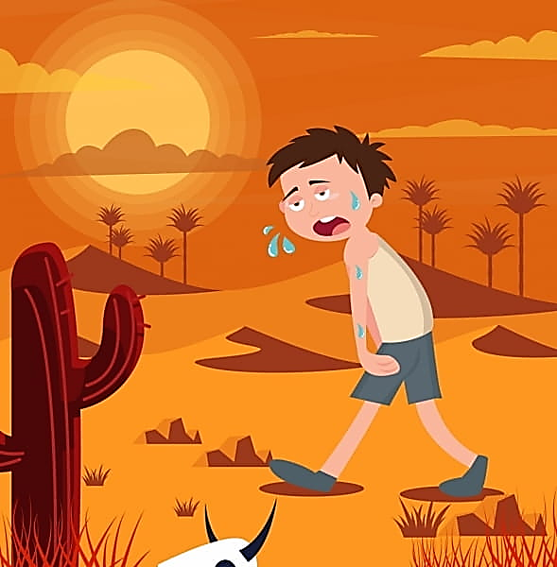
Hot

Slide 14
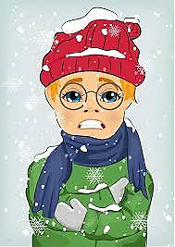
Cold

Slide 15
Запиши новые слова и выучи их
Weather [ˈweðə] погода
sunny [ˈsʌni] солнечный
rainy [ˈreɪnɪ] дождливый
windy [ˈwɪndɪ]ветряный
snowy [ˈsnəʊɪ] снежный
cloudy [ˈklaʊdɪ] облачный
hot [hɔt] жаркий
warm [wɔːm] теплый
cold [kəʊld] холодный
How’s the weather? – Какая погода?
What is the weather like today?- Сегодня какая погода?
It’s… - Сегодня…

Slide 16
Choose the right picture:
2
Cold
Hot
Warm
Windy
Cloudy
Rainy
Snowy
Sunny
6
1
2
3
3
4
7
1
4
5
6
5
8
7
8

Slide 17
Translate:
Дождливая
Солнечная
Ветреная
Теплая
Облачная
Жаркая
Снежная
Холодная
Rainy
Sunny
Windy
Warm
Cloudy
Hot
Snowy
Cold

Slide 18
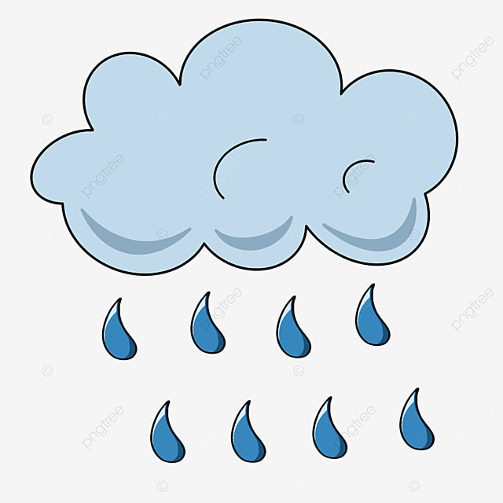
Answer the question:
- How’s the weather?
- It is rainy.

Slide 19
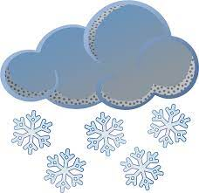
Answer the question:
- How’s the weather?
- It is snowy.

Slide 20
Answer the question:
- How’s the weather?
- It is
windy.

Slide 21
Answer the question:
- What is the weather like today?
- It is hot.

Slide 22
Answer the question:
- What is the weather like today?
- It is cold.

Slide 23
Answer the question:
- How’s the weather?
- It is sunny.

Slide 24
Answer the question:
- What is the weather like today?
- It is
cloudy.

Slide 25
What word is missing?
It is warm

