Slide 1
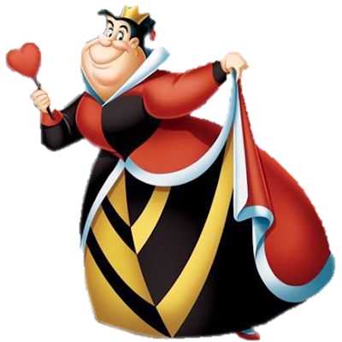
Your Own Game

Slide 2
10
20
30
40
Animals
Colours
Numbers
School
10
20
30
40
10
20
30
40
10
20
30
40

Slide 3
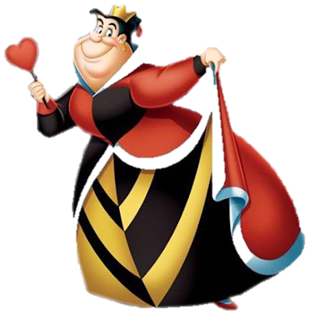
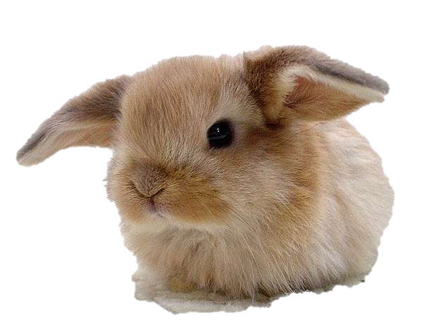
Who is it?
a rabbit
Back

Slide 4
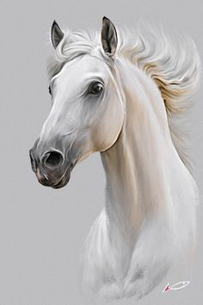
Who is it?
a horse
Back

Slide 5
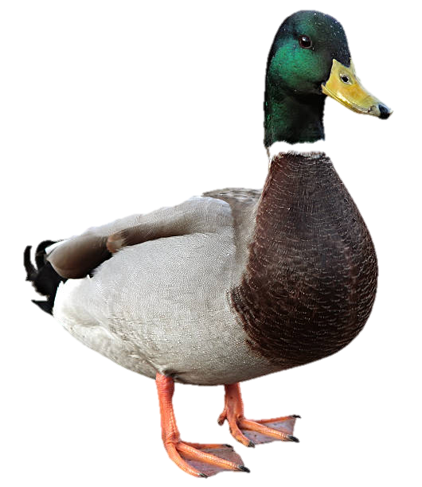
Who is it?
a duck
Back

Slide 6
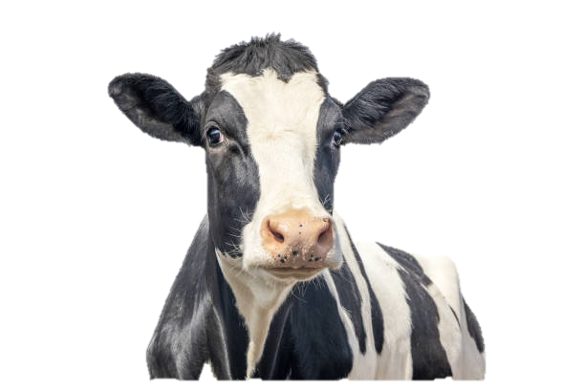
Who is it?
a cow
Back

Slide 7
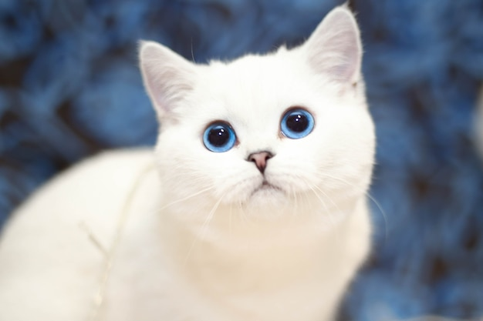
What colour is the cat?
white
Back

Slide 8
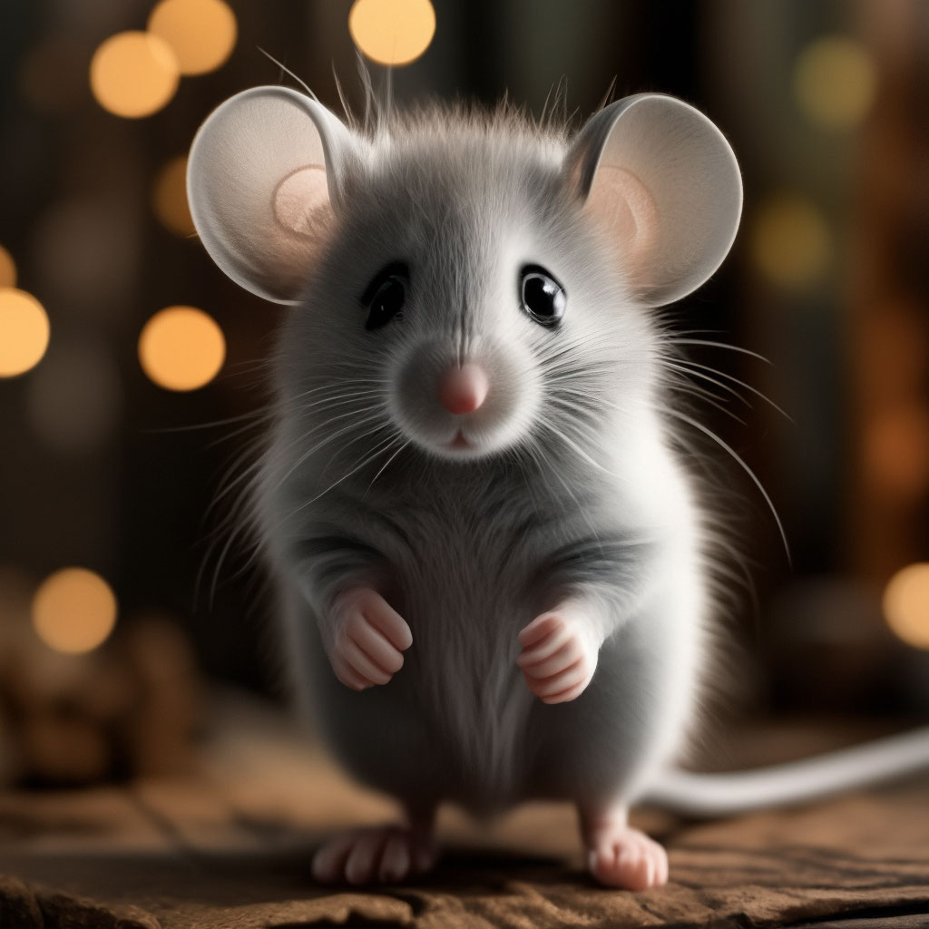
What colour is the mouse?
grey
Back

Slide 9
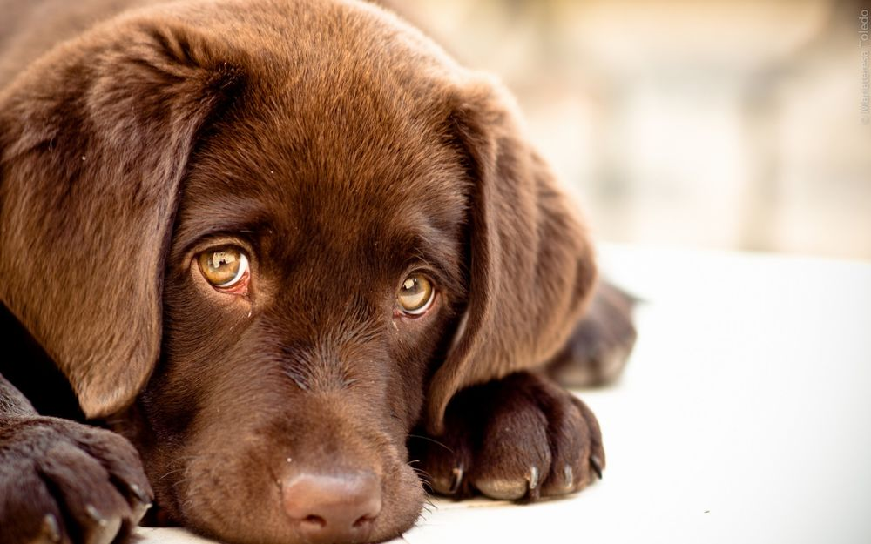
What colour is the dog?
brown
Back

Slide 10
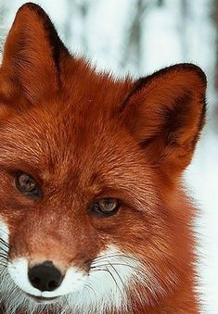
What colour is the fox?
red
Back

Slide 11
What number is it?
eight
восемь
Back

Slide 12
What number is it?
eleven
одиннадцать
Back

Slide 13
What number is it?
twenty
двадцать
Back

Slide 14
What number is it?
thirteen
тринадцать
Back

Slide 15
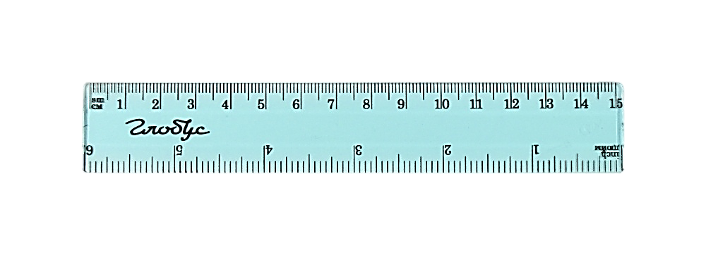
What is it?
a ruler
Back

Slide 16
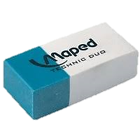
What is it?
Back
a rubber

Slide 17
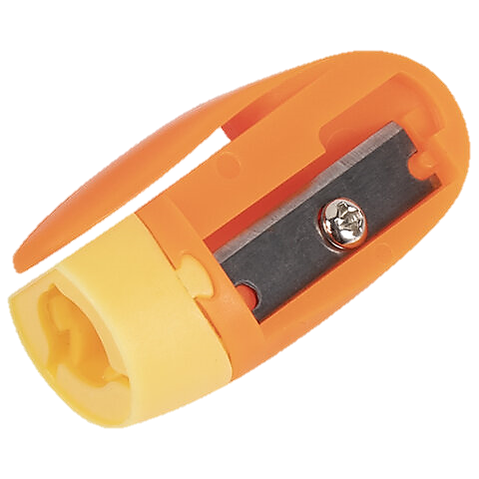
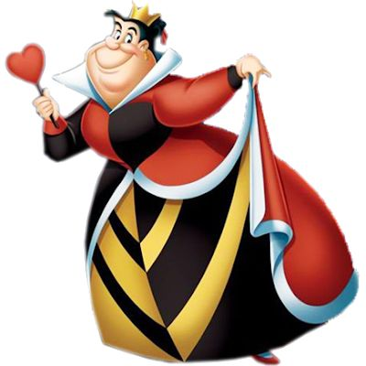
What is it?
a sharpener
Back

Slide 18
What is it?
a crayon
Back

Slide 19
What is your score?
You are well done!

